Slide 1
A 2-Approximation Algorithm for Sorting Signed Permutations by Reversals, Transpositions, Trans-Reversals, and Block-Interchanges
FanChang Hao, Melvin Zhang, and Hon Wai Leong
Review for TCBB
Ron Zeira
5.8.15

Slide 2
Outline
Introduction
Motivation
Genome rearrangement model
Breakpoint graph
Bridge structures
Algorithm
Discussion and summary

Slide 3
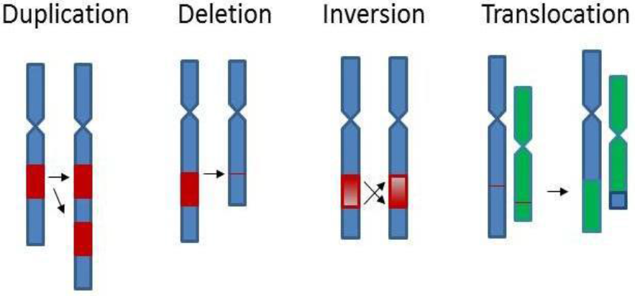
Genome rearrangements

Slide 4
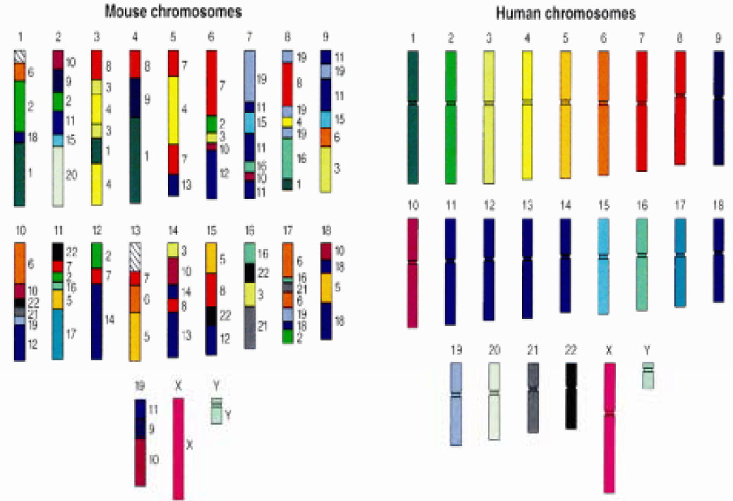
Motivation: evolution
Human genome project

Slide 5
Computational Genomics
Prof. Ron Shamir & Prof. Roded Sharan
School of Computer Science, Tel Aviv University

Slide 6
GR distance problem
Distance d_{op}(A,B) – minimal number of operations between genomes A and B.
Operations:
Reversals
Translocations
Transpositions
Others…

Slide 7
Genomes
A genome is a signed permutation of genes:
Goal: sort A into the identity permutation:
Add dummy genes (telomeres):
A=( 1 -3 -2 4 6 -5 )
ID=( 1 2 3 4 5 6 )
A=( 0 1 -3 -2 4 6 -5 7 )
ID=( 0 1 2 3 4 5 6 7 )

Slide 8
Reversals
A reversal (inversion) rev(i,j) (0≤i<j<n+1) reverses the segment a_{i+1}…a_{j} .
rev(1,3):

Slide 9
Transpositions
A transposition tp(i,j,k) (0≤i<j<k<n+1) transposes the two segments a_{i+1}…a_{j} and a_{j+1}…a_{k} .
tp(4,5,6):

Slide 10
Transreversal
A transreversal tr(i,j,k) (0≤i<j<k<n+1) reverses one of the segments a_{i+1}…a_{j} and a_{j+1}…a_{k} then transposes them.
A left/right transreversal reverses the left/right segment.
right-tr(4,5,6)
left-tr(4,5,6)

Slide 11
Block-interchange
A block-interchange bi(i,j,k,l) (0≤i<j<k<l<n+1) interchanges the two segments a_{i+1}…a_{j} and a_{k+1}…a_{l} .
bi(1,3,4,6)

Slide 12
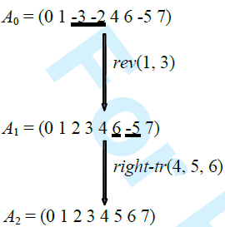
Distance problem
Given a genome A find d(A), the minimal number of reversals, transpositions, transreversals and block-interchanges that transform A into ID.
A=( 0 1 -3 -2 4 6 -5 7 )

Slide 13
Previous results
Hannenhalli and Pevzner (95) – reversal distance is polynomial.
Transposition distance is NP-hard. Several 1.5-approximations.
He and Chen – 2-approximation for sorting by reversals and block-interchanges.
Hartman and Sharan – 1.5-approximation for sorting by transpositions and transreversals.

Slide 14
Breakpoint graph vertices
Gene +x → ordered pair of vertices (xt,xh)
Gene -x → ordered pair of vertices (xh,xt)
Dummy genes: 0→0h, n+1→(n+1)t

Slide 15
Breakpoint graph edges
Gray edges (i-1h,it) (dotted round) represent adjacencies in ID.
Black edges [R(a_{i-1}),L(a_{i})] (solid straight) represent adjacencies in A.

Slide 16
Breakpoint graph properties
Each vertex has degree 2: 1 black, 1 gray
Disjoint cycles: short=2, long>2
An alternating path <v₁, v_{m}>=v₁,v₂,…,v_{m}
Gray/black paths.

Slide 17
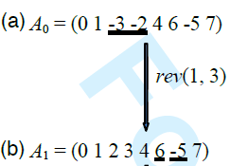
Reversals
Reversal rev(i,j):
Cut black edges [R(a_{i}),L(a_{i+1})],[R(a_{j}),L(a_{j+1})].
Add black edges [R(a_{i}), R(a_{j})],[L(a_{i}),L(a_{j+1})].

Slide 18
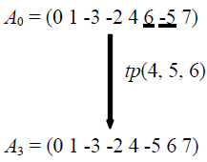
Transpositions
Transposition tp(i,j,k) :
Cut [R(a_{i}),L(a_{i+1})],[R(a_{j}),L(a_{j+1})],[R(a_{k}),L(a_{k+1})]
Add [R(a_{i}),L(a_{j+1})],[R(a_{k}),L(a_{i+1})],[R(a_{j}),L(a_{k+1})]

Slide 19
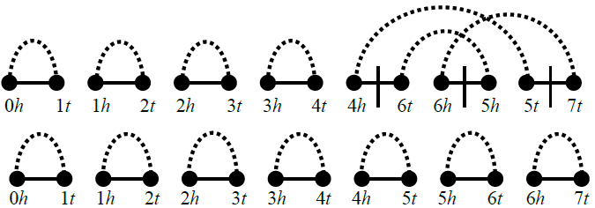
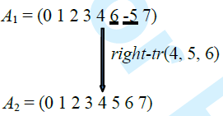
Right transreversals
Right transreversal right-tp(i,j,k) :
Cut [R(a_{i}),L(a_{i+1})],[R(a_{j}),L(a_{j+1})],[R(a_{k}),L(a_{k+1})]
Add [R(a_{i}),R(a_{K})],[L(a_{j+1}),L(a_{i+1})],[R(a_{j}),L(a_{k+1})]

Slide 20
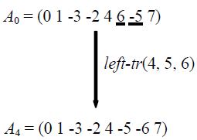
Left transreversals
Left transreversal left-tp(i,j,k) :
Cut [R(a_{i}),L(a_{i+1})],[R(a_{j}),L(a_{j+1})],[R(a_{k}),L(a_{k+1})]
Add [R(a_{i}),L(a_{j+1})],[L(a_{k}),R(a_{j})],[L(a_{i+1}),L(a_{k+1})]

Slide 21
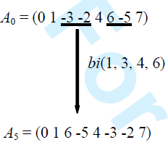
Block-interchanges
block-interchange bi(i,j,k,l):
Cut [R(a_{i}),L(a_{i+1})],[R(a_{j}),L(a_{j+1})],[R(a_{k}),L(a_{k+1})],[R(a_{l}),L(a_{l+1})]
Add[R(a_{i}), L(a_{k+1})],[R(a_{l}),L(a_{j+1})],[R(a_{k}), L(a_{i+1})],[R(a_{j}), L(a_{l+1})]

Slide 22
Increasing cycles in BP
c(A) - #cycles of BG of A.
Max for ID: c(ID)=n+1.
Let Δ(ρ) - increase of cycles from operation ρ.
Sequence of operations ρ₁,… ρ_{d}.

Slide 23
Idea
Search for ops ρ with max Δ(ρ).
An operation ρ is proper if it max Δ(ρ):
Reversals: Δ(rev)=1.
Transpositions: Δ(tp)=2.
Transreversals: Δ(tr)=2.
Block-interchanges: Δ(bi)=2 (this work).
Model proper ops with bridge structures in BG.

Slide 24
More notations
loc(u) – location of vertex u in V(G_{A}).
Even/odd locations.
u<v if loc(u)<loc(v).
Black edges [u,v]<[w,x] if u<w.
0 1 2 3 4 5 6 7 8 9 10 11 12 13

Slide 25
More notations
Gray edge (u,v) is oriented if |loc(u)-loc(v)| is even and unoriented otherwise.
Oriented graph has >= 1 oriented edge. O.w. unoriented.
Oriented path/cycle.
0 1 2 3 4 5 6 7 8 9 10 11 12 13

Slide 26
More notations
Gray edges (u₁,v₁),(u₂,v₂) in cycle C with u₁<u₂ are crossing if u₁<u₂<v₁<v₂ or v₁<v₂<u₁<u₂.
Similar for crossing gray paths.
0 1 2 3 4 5 6 7 8 9 10 11 12 13

Slide 27
L-bridges
Models proper reversals.
Black edges [a,b],[c,d] in cycle C, the gray edges (a,c),(b,d) are oriented and crossing.
Reversing b…c increases cycles by 1.
Generalizes to gray paths.

Slide 28
T-bridges
A black edge e=[u,v] is twisted if the two gray edges (u,*), (v,*) are crossing.
T-bridge models proper tps and trs with Δ=2.
Black edges e₁=[a,b], e₂=[c,d], e₃=[e,f] in cycle C s.t. e₁< e₂< e₃ and e₂ is twisted.

Slide 29
tp-T
Both gray edges (c,*), (d,*) are unoriented.
Corresponds to proper tp of b..c and d..e.

Slide 30
Inaccurate definition
T-bridge only for cycle of length 6?
T-bridge but not proper tp:
A correct definition should consider the orientation of the paths from c/d.

Slide 31
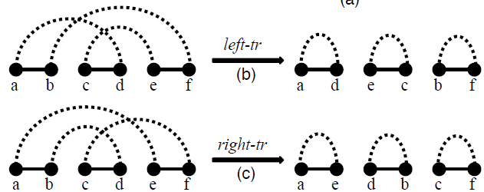
tr-T
If the gray edge (d,*) is unoriented, gray edge (c,*) oriented – left-tr
If the gray edge (d,*) is oriented, gray edge (c,*) unoriented – right-tr

Slide 32
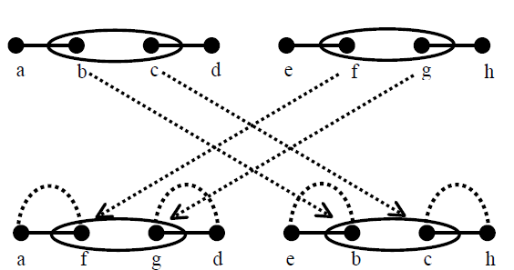
Proper bi
Lemma: Δ(bi)≤2 .
Proof: 4 black edges on the same cycle.
After bi 4 cycles

Slide 33
X-bridge
e₁<e₂ black edges on C₁, f₁<f₂ black edges on C₂. C₁ and C₂ are interleaving if e₁<f₁<e₂<f₂ or f₁<e₁<f₂<e₂.
X-bridge models proper bi. Four black edges on interleaving cycles define an x-bridge.

Slide 34
Inaccurate definition
X-bridge but not proper bi:
A correct definition should on unorienetd interleaving cycles.

Slide 35
Lower bound
Theorem: Genome A,
Proof:
Δ(ρ)≤2 for every ρ.
Optimal sequence ρ₁,… ρ_{d}

Slide 36
Upper bound
Show that we can always find either an L-,T- or X-bridge in every BG.
Classify BG:
Oriented graph → has L-bridge.
Unoriented with crossing paths → has T-bridge.
Unoriented without crossing paths → has x-bridge.

Slide 37
Claim 1
Claim 1: oriented graph → L-bridge
Pick an oriented edge and close a cycle with a crossing path.

Slide 38
Claim 2
Claim 2: Unoriented with crossing paths → T-bridge.
Pick two crossing paths p₁=<u₁,v₁>, p₂=<u₂,v₂> in a cycle C.
Depending on the parity of the u₁,u₂ contract C into a tp-T-bridge.

Slide 39
Claim 3
Claim 3: Unoriented without crossing paths → X-bridge.
Gu et al.: If cycle C has no crossing edges then there is a cycle C’ interleaving with C.
Pick leftmost and rightmost black edges in C an C’ to form an X-bridge.

Slide 40
2-approximation
Genome Sorting by Bridges (GSB) algorithm iteratively searches for L-,T- or X-bridges.
Theorem: A GSB algorithm gives a 2-approximation.
Proof:
m(A) – #ops done by GSB.
Since Δ(ρ)≥1 for every ρ:
From previous theorem:

Slide 41
GSB-X
Naïve implementation O(n⁶).
In a different paper they show O(n³).

Slide 42
Discussion notes
GSB actually does not use transreversals.
Not all proper operations are covered by the bridges.
Example of proper bi but not x-bridge:

Slide 43
Future directions
Analyze running time.
Better approximation.
Different weights.
Multiple gene copies.

Slide 44
Pros
Nice result.
Extensive rearrangement model.
Paper is mostly self contained.

Slide 45
Cons
Inaccurate bridge definitions.
Many minor comments.
A lot of grammar mistakes.
Innovation is debatable.

